Slide 1
Auditing Your APKs Like a Black Hat Hacker
Evading Android Application Vulnerability Exploitation
AndroidTO | 11.06.18

Slide 2



$whoami
KRISTINA BALAAM
Security Intelligence Engineer @ Lookout
Formerly Application Security Engineer @ Shopify
MSc. Student in Information Security Engineering, SANS Tech
@CHMODXX_
@CHMODXX
blog.chmodxx.net

Slide 3

DISCLAIMER
The information provided is intended to educate mobile developers & application security engineers to better protect their applications.
Use these techniques to build solid apps and audit those within your company.
If you want to hack for $$ and fame, please join a bug bounty program like HackerOne or BugCrowd.
Be responsible and disclose vulnerabilities
🖤
@CHMODXX_
@CHMODXX
blog.chmodxx.net

Slide 4

AGENDA
AUDITING YOUR APKS LIKE A BLACK HAT HACKER
Intro to Reverse Engineering
Common Attack Surfaces
Finding Common Vulns
Fixing Common Vulns
Continued Learning

Slide 5
> INTRO TO REVERSE ENGINEERING

Slide 6
REVERSE ENGINEERING
The process of analyzing a subject system to identify the system's components and their interrelationships and to create representations of the system in another form or at a higher level of abstraction
IEEE
@CHMODXX_
@CHMODXX
blog.chmodxx.net
Notes:
"subject system" is the end product of software development.
Reverse engineering is a process of examination only: the software system under consideration is not modified (which would make it re-engineering or restructuring). Reverse engineering can be performed from any stage of the product cycle, not necessarily from the functional end product.

Slide 7
WHY DO WE REVERSE ENGINEER OUR APPS?
https://github.com/OWASP/owasp-mstg/blob/master/Document/0x04c-Tampering-and-Reverse-Engineering.md
To enable black-box testing of mobile apps.
To enhance static analysis in black-box security testing.
To assess resilience against reverse engineering.
@CHMODXX_
@CHMODXX
blog.chmodxx.net
Notes:
Modern apps often include controls that will hinder dynamic analysis. SSL pinning and end-to-end (E2E) encryption sometimes prevent you from intercepting or manipulating traffic with a proxy. Root detection could prevent the app from running on a rooted device, preventing you from using advanced testing tools. You must be able to deactivate these defenses.
In a black-box test, static analysis of the app bytecode or binary code helps you understand the internal logic of the app. It also allows you to identify flaws such as hardcoded credentials.
Apps that implement the software protection measures listed in the Mobile Application Security Verification Standard Anti-Reversing Controls (MASVS-R) should withstand reverse engineering to a certain degree. To verify the effectiveness of such controls, the tester may perform a resilience assessment as part of the general security test. For the resilience assessment, the tester assumes the role of the reverse engineer and attempts to bypass defenses.

Slide 8




I ♥ LINUX
These examples are going to use Linux but most - if not all of these tools - will run on other OSes as well.
KALI LINUX
SANTOKU LINUX
UBUNTU
LINUX MINT
“Hacking” distro; super popular, well-supported and documented
Mobile-specific security distribution; comes loaded with all the tools you need
User-friendly, great UI, well-maintained and documented
Another favourite amongst the Linux internet population; “Vanilla” Linux
@CHMODXX_
@CHMODXX
blog.chmodxx.net

Slide 9

SETTING UP THE ENVIRONMENT
Android SDK
$ sudo apt-get install android-sdk $ sudo ln -s /usr/share/android-sdk/platform-tools/adb /bin/adb
$ sudo chmod +x /usr/share/android-sdk/tools/android
adb interacts with devices, emulators to give a shell, read logs, etc.
android manages emulators
@CHMODXX_
@CHMODXX
blog.chmodxx.net
Notes:
If you’re running a 64-bit system you’ll need to install 32-bit packages

Slide 10
SETTING UP THE ENVIRONMENT
Creating an Android Emulator
$ android sdk # install SDK platforms and tools $ android avd # create an emulator
$ emulator -avd [emulator name] # run your emulator
Getting an Interactive Shell
$ adb devices # list all devices on your computer
$ adb -s DEVICE_ID shell # start an interactive shell for DEVICE_ID
Emulators get root by default (!!!) but don’t always work properly for hardware tests
@CHMODXX_
@CHMODXX
blog.chmodxx.net
Notes:
If you’re running a 64-bit system you’ll need to install 32-bit packages

Slide 11
SETTING UP THE ENVIRONMENT
Download from your connected device via adb
Third-party download sites like https://apkpure.com/ and https://apkbucket.net**
$ adb pull [REMOTE] [LOCAL]
** Sketchy. Proceed with caution.
@CHMODXX_
@CHMODXX
blog.chmodxx.net
Notes:
If you’re running a 64-bit system you’ll need to install 32-bit packages

Slide 12

APKTool
Converts resources back to pretty much their original form
DEX (binary Dalvik bytecode) → smali (human readable)
Allows you to decompile and recompile APKs
“A tool for reverse engineering 3rd party, closed, binary Android apps. It can decode resources to nearly original form and rebuild them after making some modifications. It also makes working with an app easier because of the project like file structure and automation of some repetitive tasks like building apk, etc.” - APKTool
https://ibotpeaches.github.io/Apktool/
$ wget https://bitbucket.org/iBotPeaches/apktool/downloads/apktool_2.3.3.jar $ wget https://raw.githubusercontent.com/iBotPeaches/Apktool/master/scripts/linux/apktool
$ mv apktool_2.3.3.jar apktool.jar $ mv -t /usr/local/bin/ apktool.jar apktool $ chmod +x apktool; chmod +x apktool.jar $ apktool d [APPLICATION].apk # decompile the apk
@CHMODXX_
@CHMODXX
blog.chmodxx.net
Notes:
Decodes your resources
Works fine on OSX

Slide 13
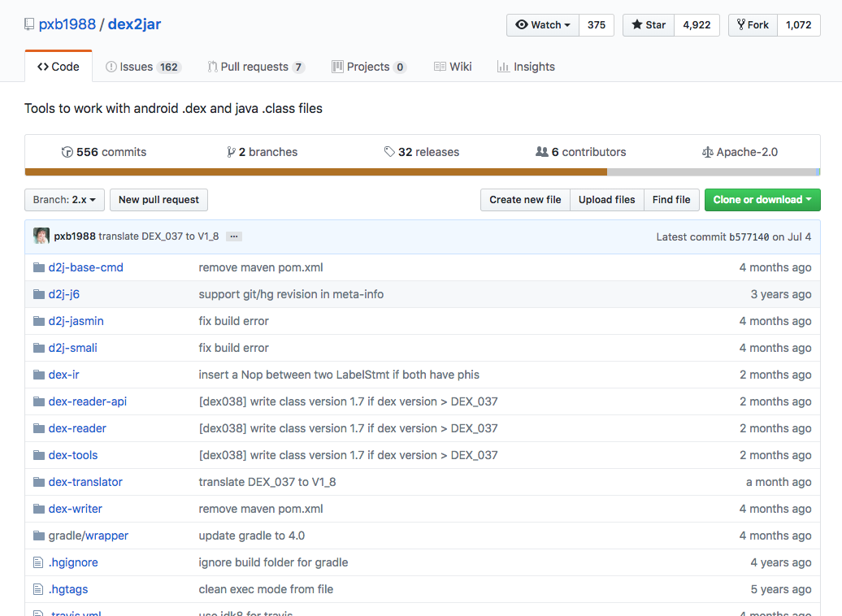
dex2jar
Converts .dex files to .class files and packages them into a jar.
Necessary step for analysis in JD-GUI
https://github.com/pxb1988/dex2jar
$ git clone https://github.com/pxb1988/dex2jar.git
@CHMODXX_
@CHMODXX
blog.chmodxx.net
Notes:
Works great on OSX

Slide 14
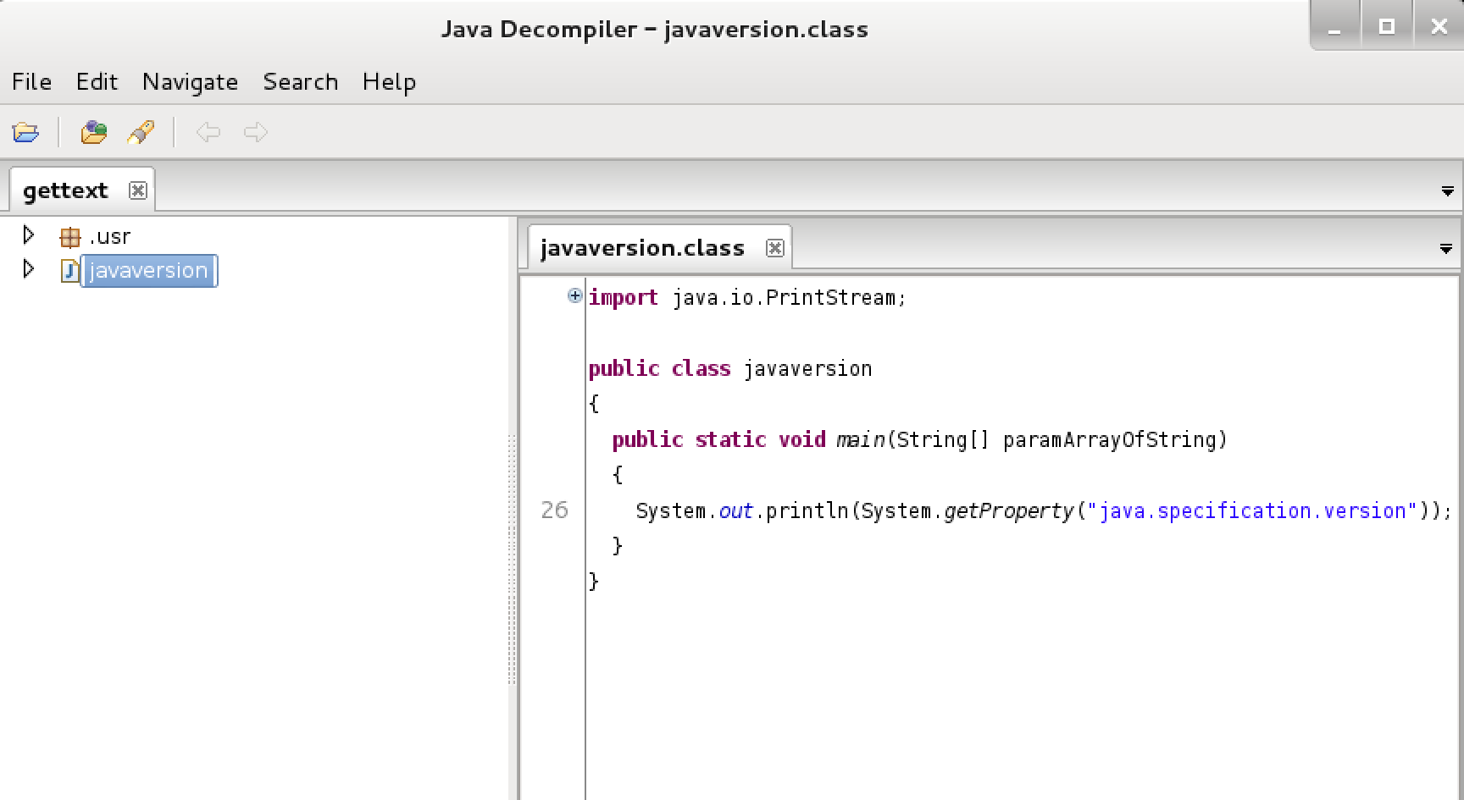

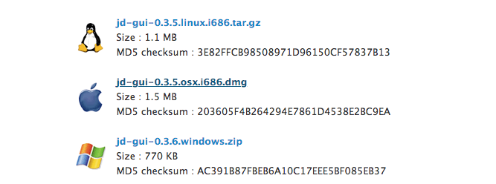
JDGUI
Displays a somewhat accurate representation of the .class files converted by Dex2Jar
kali.org
JD is a Decompiler for the Java programming language. JD is provided as a GUI tool as well as in the form of plug-ins for the Eclipse and IntelliJ IDEA integrated development environments.
https://github.com/java-decompiler/jd-gui
$ wget https://github.com/java-decompiler/jd-gui/releases/download/v1.4.0/jd-gui_1.4.0-0_all.deb
$ sudo dpkg -i jd-gui_x.x.x-x_all.deb
@CHMODXX_
@CHMODXX
blog.chmodxx.net
Notes:
Works great on OSX

Slide 15
DIVA - Damn Insecure (and) Vulnerable App
https://github.com/payatu/diva-android | https://github.com/tjunxiang92/Android-Vulnerabilities/blob/master/diva-beta.apk
Created by Aseem Jakhar of Payatu (http://payatu.com)
Open Source
Allows us to perform RE demos without upsetting developers
Examples of: Insecure logging, hard-coding vulnerabilities, insecure data storage, input validation, access control vulnerabilities
@CHMODXX_
@CHMODXX
blog.chmodxx.net

Slide 16

Drozer
Released 2012 at Blackhat EU
Finds vulnerabilities / Provides exploits & payloads
Agent (runs on the device and facilitates testing), Console (CLI to interact with the device), Server (routes sessions between console & agents)
“Drozer allows you to assume the role of an Android app, and to interact with other apps, through Android’s Inter-Process Communication (IPC) mechanism, and the underlying operating system.” - MWR Labs
https://labs.mwrinfosecurity.com/tools/drozer/
$ git clone https://github.com/mwrlabs/drozer/ $ cd drozer $ make deb $ sudo dpkg -i drozer-2.x.x.deb $ adb install drozer-agent-2.x.x.apk $ adb forward tcp:31415 tcp:31415 $ drozer console connect
@CHMODXX_
@CHMODXX
blog.chmodxx.net
Notes:
Android Security Testing Framework
Sucks on OSX > VirtualBox with a Linux distro is your friend

Slide 17
> COMMON ATTACK SURFACES

Slide 18

PERMISSIONS!
@CHMODXX_
@CHMODXX
blog.chmodxx.net

Slide 19
PERMISSIONS!
BROADCAST RECEIVERS!
@CHMODXX_
@CHMODXX
blog.chmodxx.net

Slide 20
PERMISSIONS!
BROADCAST RECEIVERS!
IPCS!
@CHMODXX_
@CHMODXX
blog.chmodxx.net

Slide 21
PERMISSIONS!
BROADCAST RECEIVERS!
STORAGE!
IPCS!
@CHMODXX_
@CHMODXX
blog.chmodxx.net

Slide 22
PERMISSIONS!
BROADCAST RECEIVERS!
STORAGE!
IPCS!
INTENTS!
@CHMODXX_
@CHMODXX
blog.chmodxx.net

Slide 23
PERMISSIONS!
BROADCAST RECEIVERS!
STORAGE!
IPCS!
WEBVIEWS!
INTENTS!
@CHMODXX_
@CHMODXX
blog.chmodxx.net

Slide 24
PERMISSIONS!
BROADCAST RECEIVERS!
STORAGE!
IPCS!
WEBVIEWS!
INTENTS!
CONTENT PROVIDERS!
@CHMODXX_
@CHMODXX
blog.chmodxx.net

Slide 25
PERMISSIONS!
BROADCAST RECEIVERS!
STORAGE!
LOGGING!
IPCS!
WEBVIEWS!
INTENTS!
CONTENT PROVIDERS!
@CHMODXX_
@CHMODXX
blog.chmodxx.net

Slide 26
PERMISSIONS!
BROADCAST RECEIVERS!
STORAGE!
LOGGING!
IPCS!
WEBVIEWS!
INTENTS!
CONTENT PROVIDERS!
DATA VALIDATION!
@CHMODXX_
@CHMODXX
blog.chmodxx.net

Slide 27
PERMISSIONS!
BROADCAST RECEIVERS!
STORAGE!
LOGGING!
IPCS!
WEBVIEWS!
INTENTS!
CONTENT PROVIDERS!
DATA VALIDATION!
OBFUSCATION!
@CHMODXX_
@CHMODXX
blog.chmodxx.net

Slide 28
PERMISSIONS!
TAMPERING!
BROADCAST RECEIVERS!
STORAGE!
LOGGING!
IPCS!
WEBVIEWS!
INTENTS!
CONTENT PROVIDERS!
DATA VALIDATION!
OBFUSCATION!
@CHMODXX_
@CHMODXX
blog.chmodxx.net

Slide 29

PERMISSIONS!
TAMPERING!
BROADCAST RECEIVERS!
STORAGE!
LOGGING!
IPCS!
WEBVIEWS!
INTENTS!
CONTENT PROVIDERS!
DATA VALIDATION!
OBFUSCATION!
@CHMODXX_
@CHMODXX
blog.chmodxx.net

Slide 30
> FINDING & FIXING COMMON VULNS

Slide 31

@CHMODXX_
@CHMODXX
blog.chmodxx.net

Slide 32
PERMISSIONS
APPLICATION PERMISSION
Developers often ask for more permissions than they need.
Most users will accept anything they’re asked.
Err on the side of caution and do whatever you can to make the attack surface smaller.
What to Do:
Follow the Principle of Least Privilege
Define permissions with signature protection so no other applications can access components or request permissions
Make sure the permissions you’re requesting are really necessary -- let native apps handle functionality
Eg. Only need READ permissions? Don’t grant READWRITE.
dz> run app.package.info -a [PACKAGE-NAME]
@CHMODXX_
@CHMODXX
blog.chmodxx.net
Notes:
Even though you can trust your app, you never know what the user has installed on their phone
Principle of least privilege (PoLP, also known as the principle of minimal privilege or the principle of least authority) requires that in a particular abstraction layer of a computing environment, every module (such as a process, a user, or a program, depending on the subject) must be able to access only the information and resources that are necessary for its legitimate purpose
Drozer command to show all the permissions for the application

Slide 33
PERMISSIONS
FILE PERMISSIONS
Only for files stored externally.
You can define file permissions in AndroidManifest and in the code.
Malware loves searching for files in SD Cards
What to Do:
Don’t give MODE_WORLD_READABLE or MODE_WROLD_WRITABLE permissions if you can help it
they allow other applications to access the file
Share files between the Content Provider; avoid external storage where you can
@CHMODXX_
@CHMODXX
blog.chmodxx.net
Notes:
Even though you can trust your app, you never know what the user has installed on their phone
Principle of least privilege (PoLP, also known as the principle of minimal privilege or the principle of least authority) requires that in a particular abstraction layer of a computing environment, every module (such as a process, a user, or a program, depending on the subject) must be able to access only the information and resources that are necessary for its legitimate purpose
Drozer command to show all the permissions for the application

Slide 34
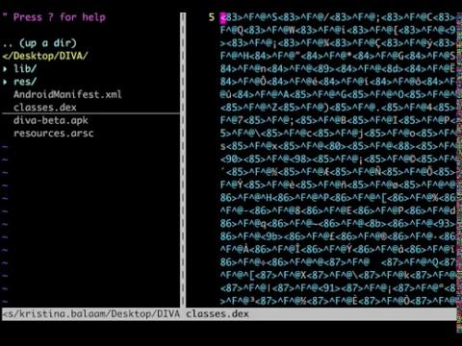
CHECKING THE MANIFEST
@CHMODXX_
@CHMODXX
blog.chmodxx.net

Slide 35
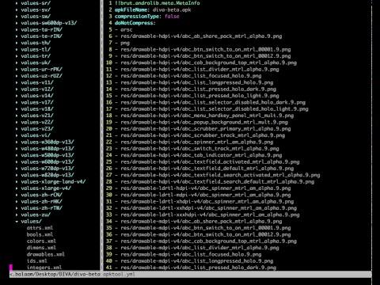
CHECKING THE MANIFEST
@CHMODXX_
@CHMODXX
blog.chmodxx.net

Slide 36
IPCS
(INTERPROCESS COMMUNICATIONS)
Services, Activities, BroadcastReceivers, ContentProviders
Endpoints aren’t always secured
They act as data sinks and sources.
Broadcast messages allow any application to receive an intent!
Malicious apps could gain access to another’s data
ContentProviders: could expose access to data and directory traversal or SQL injection attacks; when not permissions protected, any application can invoke
Activities: could be used in a UI-redressing attack
BroadCast Receivers: could be hijacked to intercept an Intent & its data; null values can also be sent to DoS applications
Services: Could expose application-specific functionality
@CHMODXX_
@CHMODXX
blog.chmodxx.net
Notes:
Broadcast Receivers: since sending broadcast intents allows another app to receive and process the data.
Abuse case dependent on their purpose: protection typically achieved by way of app permissions
Eg. Application may define an IPC endpoint that should be accessible only be other components in that application or by applications that request the permission required to interact with them
UI-redressing = ClickJacking: A visitor to a site thinks he is clicking on a button to close a window; instead, the action of clicking the “X” button prompts the computer to download a Trojan horse, transfer money from a bank account or turn on the computer’s built-in microphone or webcam.

Slide 37
IPCS
(INTERPROCESS COMMUNICATIONS)
What to Do:
Share files using ContentProvider; avoid external storage (like SDCards) where you can
Android versions before 4.2 export content providers by default. Ensure this is false for any apps whose targeted SDK version is <= 16
Even content providers that aren’t exported can be accessed by privileged users
Similarly, exported activities require no permissions for interaction
When using ContentProviders, always ensure a permission is set for the required application
Sanitize inputs or use prepared statements with ContentProviders to avoid SQL injection attacks
Use explicit intents wherever possible
Use custom permissions with services, too (can be checked by service when external service makes a request)
Use the local broadcast manager for local intents
No other application can access the data
sendBroadcast(intent); and sendStickyBroadcast(intent); are susceptible to IPC sniffing. Use intents signed with permissions so an unauthorized app can’t receive the intent!
Check the data being received from any broadcast and ensure that it’s valid!
@CHMODXX_
@CHMODXX
blog.chmodxx.net
Notes:
Broadcast Receivers: since sending broadcast intents allows another app to receive and process the data.
Abuse case dependent on their purpose: protection typically achieved by way of app permissions
Eg. Application may define an IPC endpoint that should be accessible only be other components in that application or by applications that request the permission required to interact with them
UI-redressing = ClickJacking: A visitor to a site thinks he is clicking on a button to close a window; instead, the action of clicking the “X” button prompts the computer to download a Trojan horse, transfer money from a bank account or turn on the computer’s built-in microphone or webcam.

Slide 38
IPCS
USEFUL DROZER COMMANDS
dz> run app.provider.info -a [PACKAGE NAME]
# list all exported content providers
dz> run app.provider.info -a [PACKAGE NAME] -u
# list all non-exported content providers
dz> run app.activity.info -a [PACKAGE NAME]
# list all exported activities
dz> run scanner.provider.injection -a
# scan for sql injection vulns
@CHMODXX_
@CHMODXX
blog.chmodxx.net
Notes:
Broadcast Receivers: since sending broadcast intents allows another app to receive and process the data.
Abuse case dependent on their purpose: protection typically achieved by way of app permissions
Eg. Application may define an IPC endpoint that should be accessible only be other components in that application or by applications that request the permission required to interact with them
UI-redressing = ClickJacking: A visitor to a site thinks he is clicking on a button to close a window; instead, the action of clicking the “X” button prompts the computer to download a Trojan horse, transfer money from a bank account or turn on the computer’s built-in microphone or webcam.

Slide 39
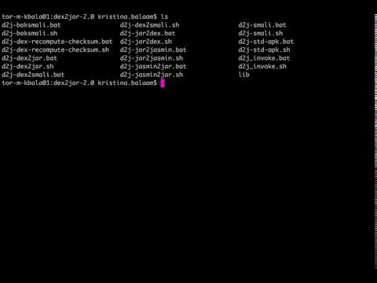
ANALYZING SOURCE CODE
@CHMODXX_
@CHMODXX
blog.chmodxx.net

Slide 40
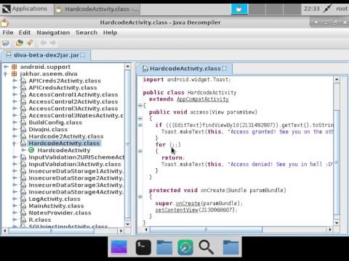
ANALYZING SOURCE CODE
@CHMODXX_
@CHMODXX
blog.chmodxx.net

Slide 41
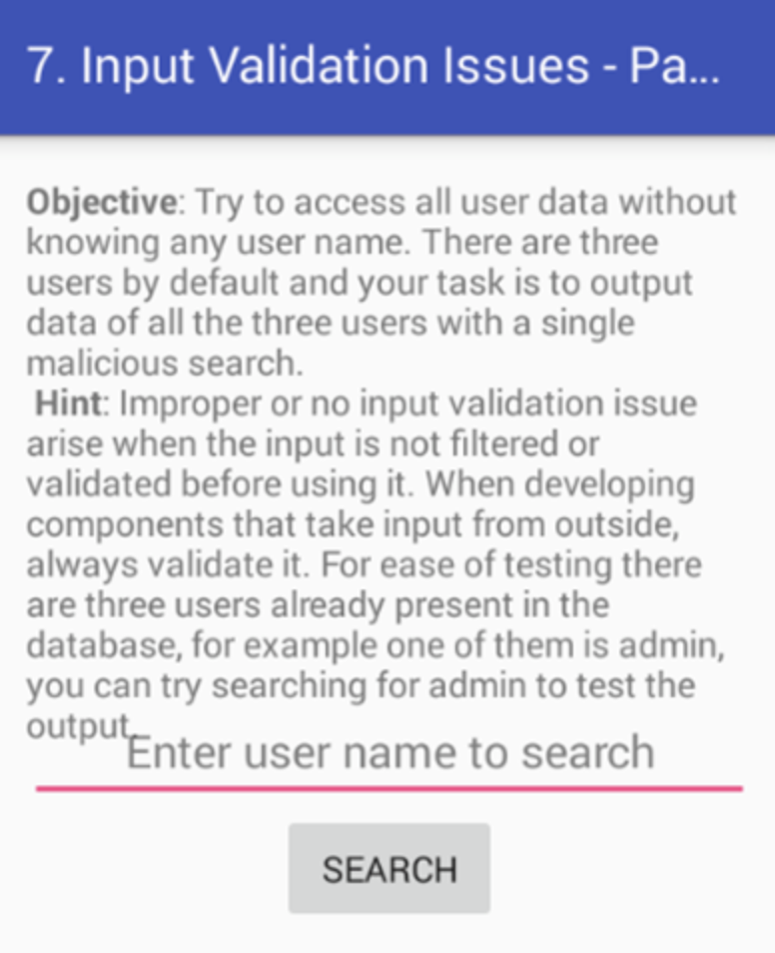
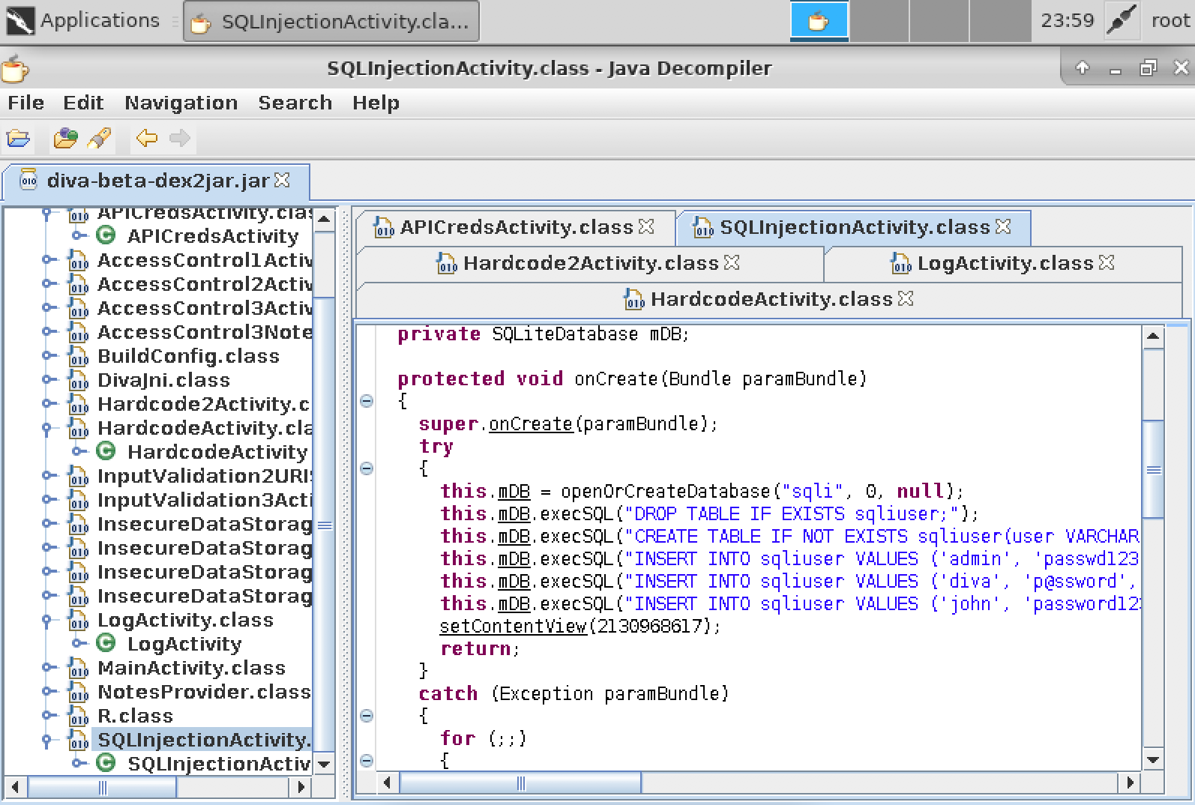
DIVA SQL Injection
@CHMODXX_
@CHMODXX
blog.chmodxx.net

Slide 42
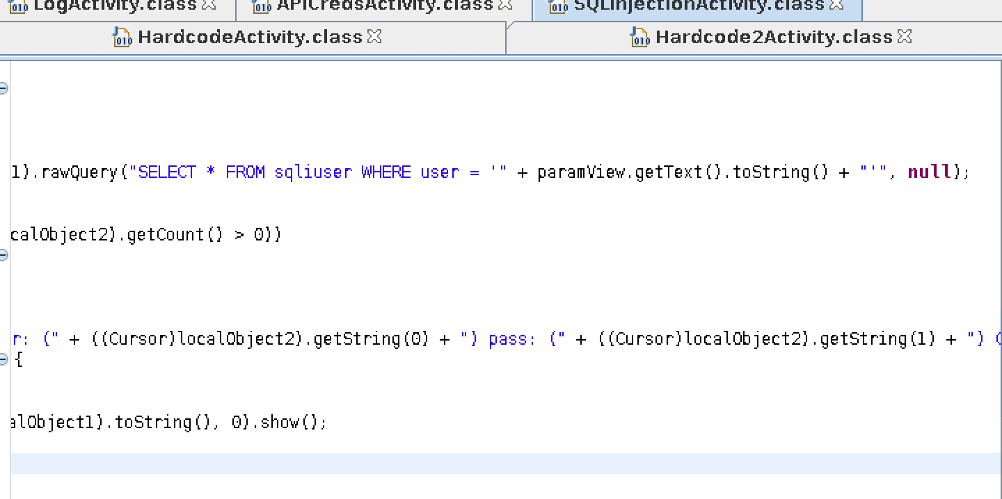
DIVA SQL Injection
@CHMODXX_
@CHMODXX
blog.chmodxx.net

Slide 43

REAL WORLD EXAMPLE
Samsung Kies, Galaxy S3
Kies was highly privileged: connects mobile phone to your PC
Had a BroadCast receiver that restored APKs from the SDcard
Tldr; Kies has a call chain that iterates through the sdcard/restore directory and installs every APK
A researcher was able to add their app to the SD card by exploiting a WRITE_EXTERNAL_STORAGE privilege issue with the clipboard service on the S3, and then had Kies call that function with an intent
http://sh4ka.fr/android
@CHMODXX_
@CHMODXX
blog.chmodxx.net
Notes:
To change the image behind the Mock up.
Select the layer - > Right Click -> Send to Back -> Delete the image -> Drag & Drop your Own Picture -> Send to Back (again)

Slide 44
INSECURE STORAGE
Apps are super easy to RE
.apks are basically just .zip files
Data should be stored in either:
/data/data/<package>
Only accessible by the application unless it gives permission or if the device is rooted
/sdcard
Accessible by everyone
Process information can be dumped to access sensitive info.
Don’t embed any encryption key in source code.
If an attacker has access to a phone, and the memory isn’t cleared after the app is closed, they could access anything stored.
WebViews allow HTML data to cache locally.
@CHMODXX_
@CHMODXX
blog.chmodxx.net
Notes:
Someone wrote a script that iterated through every string in the classes.dex file and tested it against the encrypted database file
There have been proof of concepts showing that breaking full disk encryption isn’t THAT hard
Sometimes people back up sqlite dbs on SD card

Slide 45
INSECURE STORAGE
What to Do:
Look for code that stores data locally: make sure it’s not storing sensitive data
When you absolutely have to store something client-side, make sure it’s encrypted if it’s sensitive
When you’re encrypting, use a strong encryption algorithm: avoid MD5/SHA1 hashing for passwords and instead use PBKDF2, bcrypt or scrypt.
If you’re using webviews, look at clearCache() or “no-cache” to prevent caching data altogether
Re-initialize the Application class with dummy values once it closes to prevent saved information since it remains active even when the app is closed
@CHMODXX_
@CHMODXX
blog.chmodxx.net
Notes:
Only use approved public algorithms such as AES, RSA public key cryptography, and SHA-256 or better for hashing. Do not use weak algorithms, such as MD5 or SHA1.
Avoid hashing for password storage, instead use PBKDF2, bcrypt or scrypt.
Android P - exception if not using TLS to send data
But only for new apps targeting Android P

Slide 46

REAL WORLD EXAMPLE
Skype, 2011
Skype was storing contacts, profile, IM logs plus additional personal data at /data/data/com.skype…/files/<USERNAME> in SQLite database and XML files
Permissions were improperly set -- world readable and writable -- so any app could read them. Everything was unencrypted
Skype also stored the usernames in static locations, so a malicious application could parse the shared.xml file, find the usernames and then use that value to find the files stored in data.
Reported by Justin Case (jcase), http://AndroidPolice.com
@CHMODXX_
@CHMODXX
blog.chmodxx.net
Notes:
To change the image behind the Mock up.
Select the layer - > Right Click -> Send to Back -> Delete the image -> Drag & Drop your Own Picture -> Send to Back (again)

Slide 47

REAL WORLD EXAMPLE
What’s App, 2014
Conversations stored on the phone’s SD Card
Researcher Bas Bosschert built a fake “malicious” app with a distracting load screen that requested the necessary permissions and downloaded user’s WhatsApp data while the loading screen ran
Database files were “encrypted”, but easily decrypted with a Python script and a key found on an XDA Developers forum post
Reported by Bas Bosschert, TechCrunch
@CHMODXX_
@CHMODXX
blog.chmodxx.net
Notes:
To change the image behind the Mock up.
Select the layer - > Right Click -> Send to Back -> Delete the image -> Drag & Drop your Own Picture -> Send to Back (again)

Slide 48
INSECURE COMMUNICATIONS
You can set up a proxy on an emulator.
Set the Access Point Name to 10.0.2.2 and the port to the same as what’s been specified by your Burp listener port.
New in Android P!
TLS by default, but ability to opt out for legacy domains
https://developer.android.com/training/articles/security-config
Fix: Never send plaintext requests
Web traffic inspection is an important part of the audit process
(A surprising number of developers don’t realize you can intercept web traffic -- especially on mobile)
Burp Suite is a great (free) tool for setting up an intercepting proxy for mobile testing.
@CHMODXX_
@CHMODXX
blog.chmodxx.net

Slide 49
WEBVIEWS
Renders web pages within the application
WebView lets you break out of the app sandbox and bypass same origin.
Also makes it possible to load malicious .js: any web page accessed by the frame in the app can call back to the application. And can call back Java.
Loading cleartext content is the single biggest mistake you can make
You see this a lot in apps with advertisements.
How often does this happen?
Stanford study in 2013:
40k apps minimum using a “javascript bridge”
⅓ could be reached by untrusted content
@CHMODXX_
@CHMODXX
blog.chmodxx.net
Notes:
Key distinction between handling pages in web browsers vs webviews is that the webview still runs within the context of the application & provides hooks to allow the parent app to change its behaviour at runtime
Devs are prone to disabling the code that checks for SSL errors - when you still proceed to load content with failed SSL checks, it defeats the point of having SSL --- attackers could present a different certificate
Loading cleartext content is the biggest mistake > MITM attacks
Cleartext content -- attacker could intercept the traffic and modify the responses being sent back
Other apps could intercept an intent on an exported components and open a URL

Slide 50
WEBVIEWS
What to Do:
Restrict users to the application domain
Don’t call setJavaScriptEnabled() until you absolutely have to process Javascript
APIs 17+ require methods to be marked @JavascriptInterface for any method exposed to Javascript and this prevents malicious code from accessing the lower-level OS commands
Create a whitelist of domains that are allowed to render content
Send all traffic over SSL to prevent man-in-the-middle attacks where someone tries to inject script
@CHMODXX_
@CHMODXX
blog.chmodxx.net
Notes:
Example of setJavaScriptEnabled() -- Shopify app, it’s set to prevent redirecting users to links in 3P app store pages
Facebook - set false when you open a link within Messenger
When @JavascriptInterface is tied to a method, ONLY that method can be accessed / exposed to the Javascript bridge. Other methods could not be accessed.

Slide 51
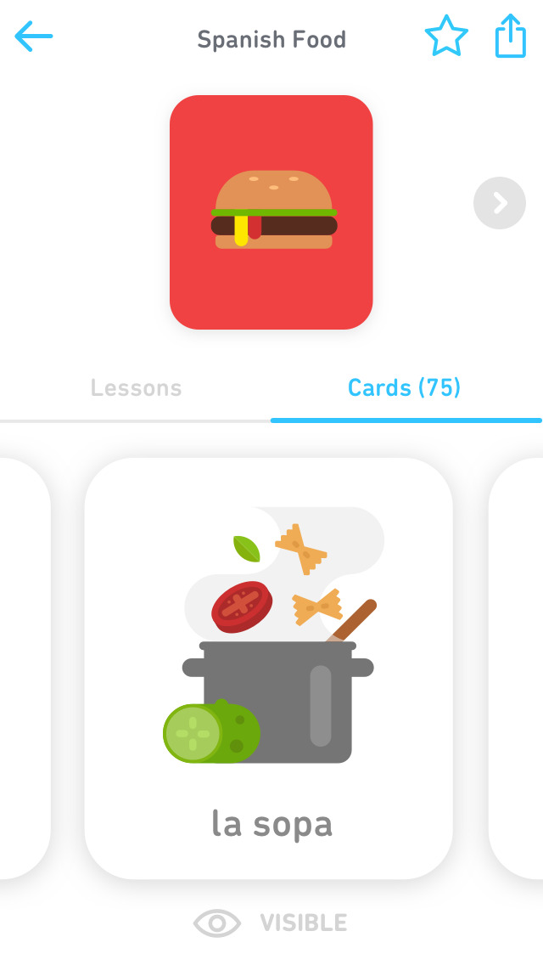
REAL WORLD EXAMPLE
TinyCards, 2018
RCE in TinyCards for Duolingo on Android
“TinyCards loads a website via webview when starting, but that site is loaded over http then redirected to https. A MITM attack that controls either the network or the DNS, can inject their own web content into the webview. You can confirm this by using an MITM proxy to capture the traffic.” - @nightwatch-cybersecurity, HackerOne
Publicly Disclosed on HackerOne: https://hackerone.com/reports/281605
@CHMODXX_
@CHMODXX
blog.chmodxx.net

Slide 52
LOGGING
Logging is great for debugging.*
*It’s also great for hackers.
Even system processes (eg. ActivityManager) log detailed messages.
Even though the READ_LOGS permission was removed for 3P Applications after 4.1, rooted devices can still access it.
$ logcat
# running from shell shows sys and app logs $ adb logcat
# same as above, just direct
@CHMODXX_
@CHMODXX
blog.chmodxx.net
Notes:
Logcat is really handy -- you can pass it in different tags for displaying specific logs
Even though 3p apps since 4.1 can’t access logs, any malicious apps still living in an SDK version prior to that can

Slide 53
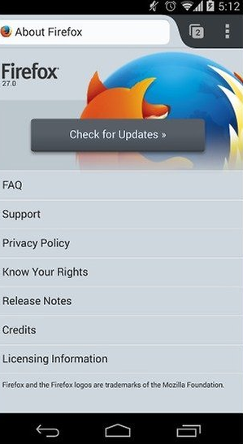
REAL WORLD EXAMPLE
Firefox, 2012
Logged browsing activity, including plain text URLs and even session IDs
Malicious application or attacker could use session IDs to hijack a victim’s session
Reported by Neil Bergman
@CHMODXX_
@CHMODXX
blog.chmodxx.net
Notes:
If you had an application that could access the logs of another application, you could parse the log file for session IDs and hijack the victim’s session

Slide 54
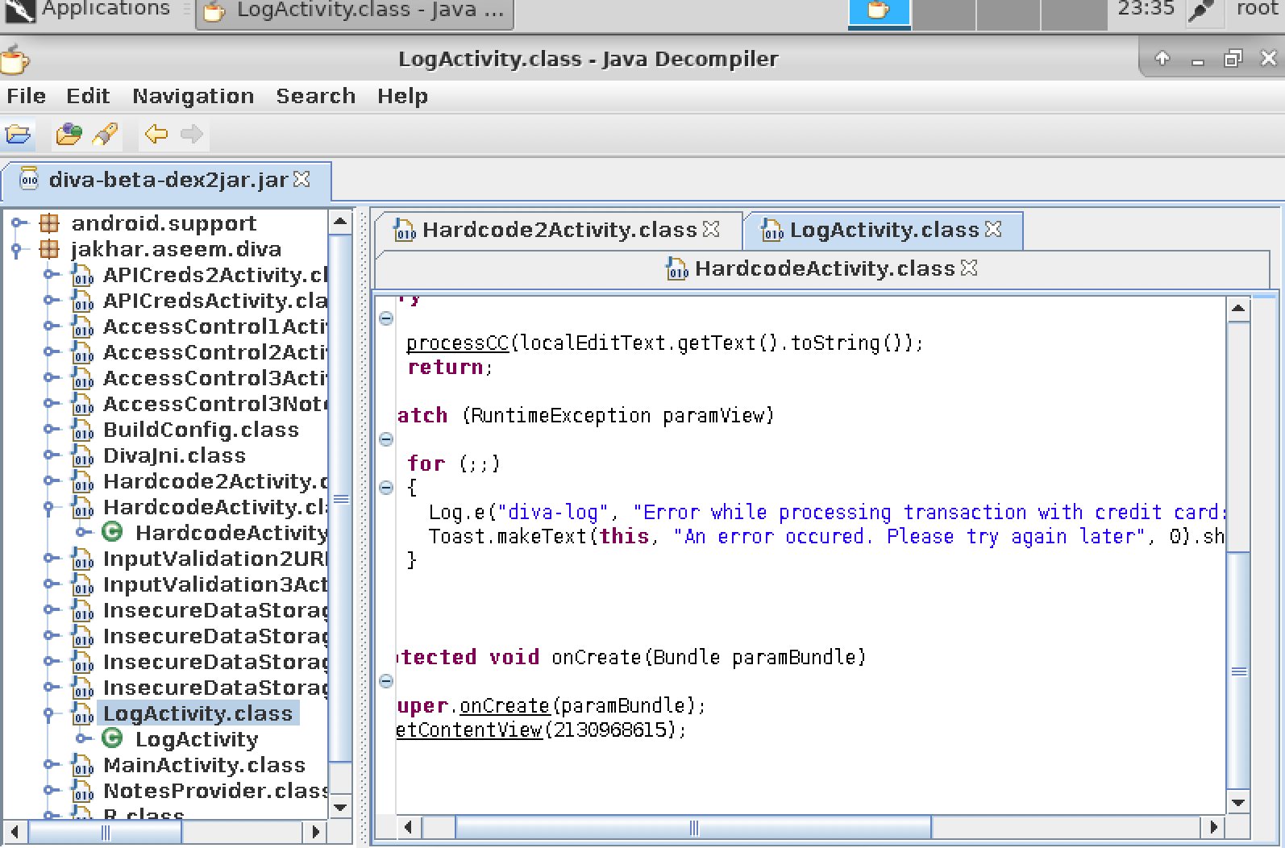
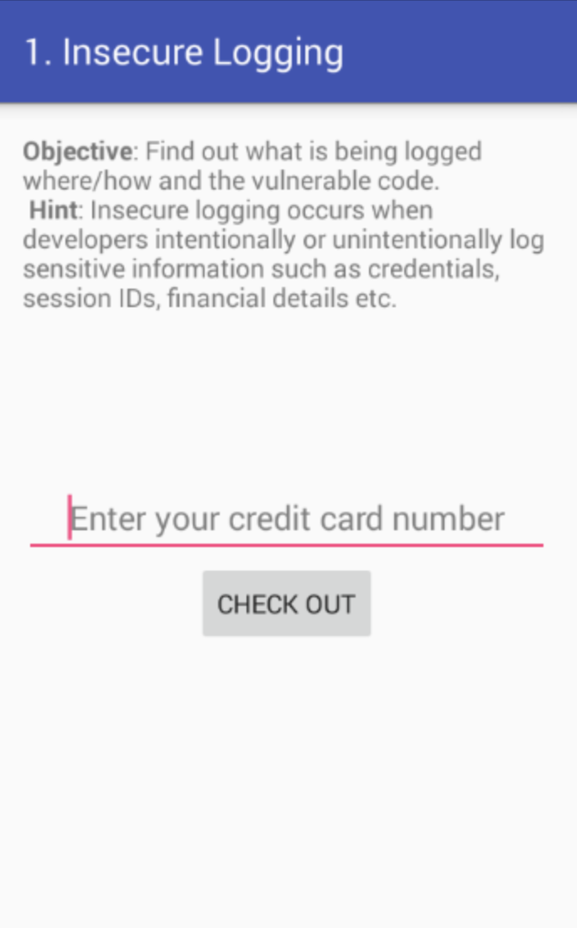
DIVA Insecure Logging
D/MobileDataStateTracker( 469): default: setPolicyDataEnable(enabled=true)
D/LightsService( 469): Excessive delay setting light: 86ms
D/dalvikvm( 1695): GC_CONCURRENT freed 136K, 6% free 3845K/4060K, paused 7ms+4ms, total 93ms
E/diva-log( 1695): Error while processing transaction with credit card: 0000000000
E/SoundPool( 469): error loading /system/media/audio/ui/Effect_Tick.ogg
@CHMODXX_
@CHMODXX
blog.chmodxx.net

Slide 55
OBFUSCATION
What to Do:
ProGuard obfuscates your code lexically: meaningful names replaced by machine-generated garble
Using native code makes decompilation harder: attacker has to resort to assembly level reversing
BUT be aware: more susceptible to issues like buffer overflows
Java reflection: code that’s able to inspect other code -- makes it harder to trace what’s happening in your app
It’s easy to RE Android apps.
You can make it harder by obfuscating your code.
Pros: Harder for people to steal your stuff or exploit
Cons: Ongoing maintenance can be tricky.
@CHMODXX_
@CHMODXX
blog.chmodxx.net
Notes:
Example of setJavaScriptEnabled() -- Shopify app, it’s set to prevent redirecting users to links in 3P app store pages
Facebook - set false when you open a link within Messenger

Slide 56
PRIVATE KEYS
What to Do:
DON’T STORE YOUR PRIVATE KEYS IN YOUR APP
Cloud KMS: Google offers cloud storage for secrets (https://cloud.google.com/kms/)
If you don’t trust Google, keep it somewhere else. Safe. Separate from the app.
Google I/O 2018 announced “StrongBox”: resistant to shared resource attacks, side channel attacks, physical attacks
Only some new devices that ship with Android P
Used for:
Signing apps
Encrypting https traffic
Private keys are included in apps ALL. THE. TIME.
Java keystore
Container for public/private keys and certificates
Password protection is optional (!!!!)
No container-level encryption
Private keys housed within share same password as keystore container by default
@CHMODXX_
@CHMODXX
blog.chmodxx.net
Notes:
People are bad at coming up with passwords, so don’t think a password will necessarily foil hackers.

Slide 57
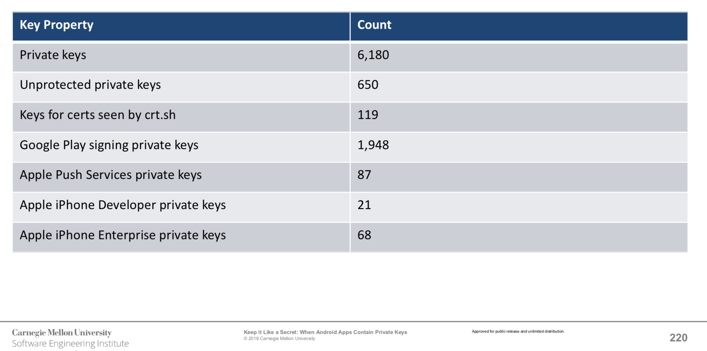
PRIVATE KEYS
June 2017, an IT security journalist finds a private key in a CISCO app.
Will Dormann of Carnegie Mellon does a study analyzing apps for exposed private keys.
Looked at 1.7M APKs
@CHMODXX_
@CHMODXX
blog.chmodxx.net
Notes:
PKCS12 used to store private keys with accompanying public key certificates, protected with a password-based symmetric key.

Slide 58
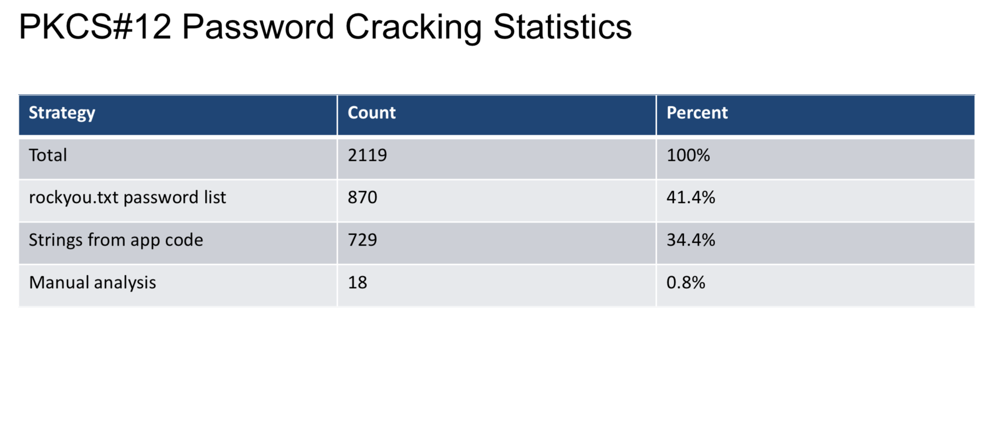
PRIVATE KEYS
June 2017, an IT security journalist finds a private key in a CISCO app.
Will Dormann of Carnegie Mellon does a study analyzing apps for exposed private keys.
Looked at 1.7M APKs
@CHMODXX_
@CHMODXX
blog.chmodxx.net
Notes:
PKCS12 used to store private keys with accompanying public key certificates, protected with a password-based symmetric key.

Slide 59
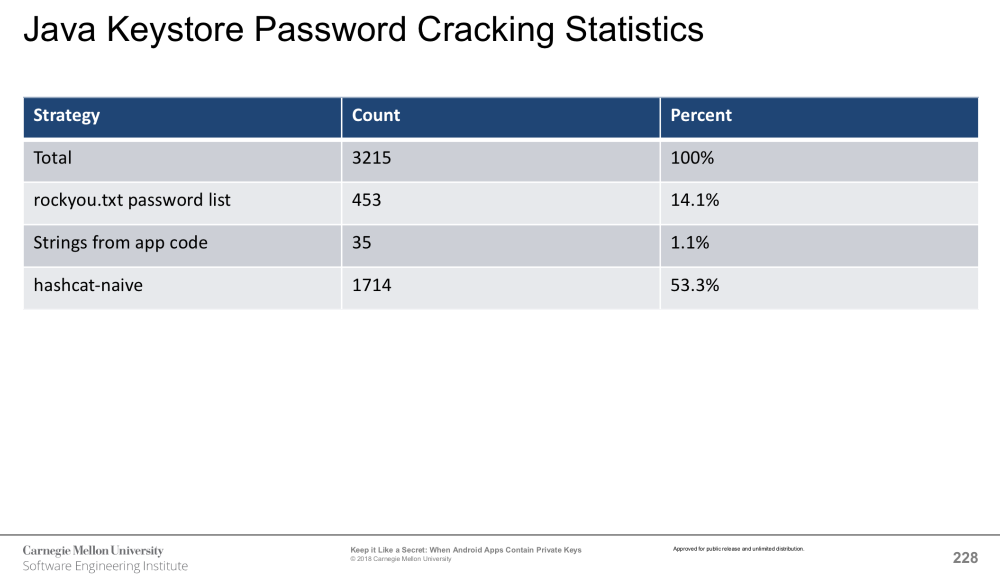
PRIVATE KEYS
June 2017, an IT security journalist finds a private key in a CISCO app.
Will Dormann of Carnegie Mellon does a study analyzing apps for exposed private keys.
Looked at 1.7M APKs
Watch the BSidesSF Talk
https://www.youtube.com/watch?v=-VjK0FMmGm4
@CHMODXX_
@CHMODXX
blog.chmodxx.net
Notes:
PKCS12 used to store private keys with accompanying public key certificates, protected with a password-based symmetric key.

Slide 60
TAMPER DETECTION
What to Do:
Avoid client-side checks
Google’s SafetyNet has some nifty tamper-detection features
Can detect whether a device is rooted (with some level of certainty)
Can determine whether a device has malware (to an extent)
Android P’s “Keystore Attestation API”: signed statement from secure hardware that the device hasn’t been tampered with
You can run system calls to check whether your application is being accessed by the Android Debug Bridge or whether the app is running on an emulator
Attackers can download an APK, modify it, re-sign it
The certificate hash would change, so it’d be obvious it wasn’t the same developer
(UNLESS YOU INCLUDE YOUR PRIVATE KEY)
But the attacker could still re-upload the app as a clone and fool people into downloading it
You can add signature checks to your code...but you’d have to be sneaky.
Determined attackers could just figure out where you’re checking for the signature and remove it.
@CHMODXX_
@CHMODXX
blog.chmodxx.net
Notes:
SafetyNet also allows server-side checking for application tampering
That can be stripped out, too. But, it’s better than pure client-side checking

Slide 61
BE PARANOID
@CHMODXX_
@CHMODXX
blog.chmodxx.net

Slide 62
BE PARANOID
ALL THE TIME
@CHMODXX_
@CHMODXX
blog.chmodxx.net

Slide 63

BE PARANOID
ALL THE TIME
JK.
@CHMODXX_
@CHMODXX
blog.chmodxx.net

Slide 64
BE PARANOID
ALL THE TIME
JK. Sort of.
@CHMODXX_
@CHMODXX
blog.chmodxx.net

Slide 65


BASIC RULES
Never trust the client
Follow the Principle of Least Privilege
Turn on the security linter in Android Studio
NEVER STORE YOUR PRIVATE KEY IN THE APP
Be as explicit as possible about your app’s intentions
Seriously, never trust the client
How to Turn on Android Security Linter
File > Settings > Editor > Inspections
http://tools.android.com/tips/lint-checks
@CHMODXX_
@CHMODXX
blog.chmodxx.net
Notes:
Principle of Least Privilege (each component or process should have only the permissions necessary to perform its tasks)
Explicit intents where you can, explicit permissions, etc.

Slide 66
> CONTINUED LEARNING

Slide 67

Android Application Security Overview
https://source.android.com/security/overview/app-security
Android Developers: App Security Best Practices
https://developer.android.com/topic/security/best-practices
OWASP Mobile Security Testing Guide (MSTG)
https://github.com/OWASP/owasp-mstg
Full DIVA Solution
https://resources.infosecinstitute.com/cracking-damn-insecure-and-vulnerable-apps-diva-part-1/#gref
Android REing Series
https://www.youtube.com/c/chmodxx
RESOURCES
@CHMODXX_
@CHMODXX
blog.chmodxx.net
Notes:
OWASP Mobile Testing Guide
Good to keep on hand for auditing
Updated regularly; Last update was May 10th 2018
Formerly the Android Testing cheat sheet

Slide 68









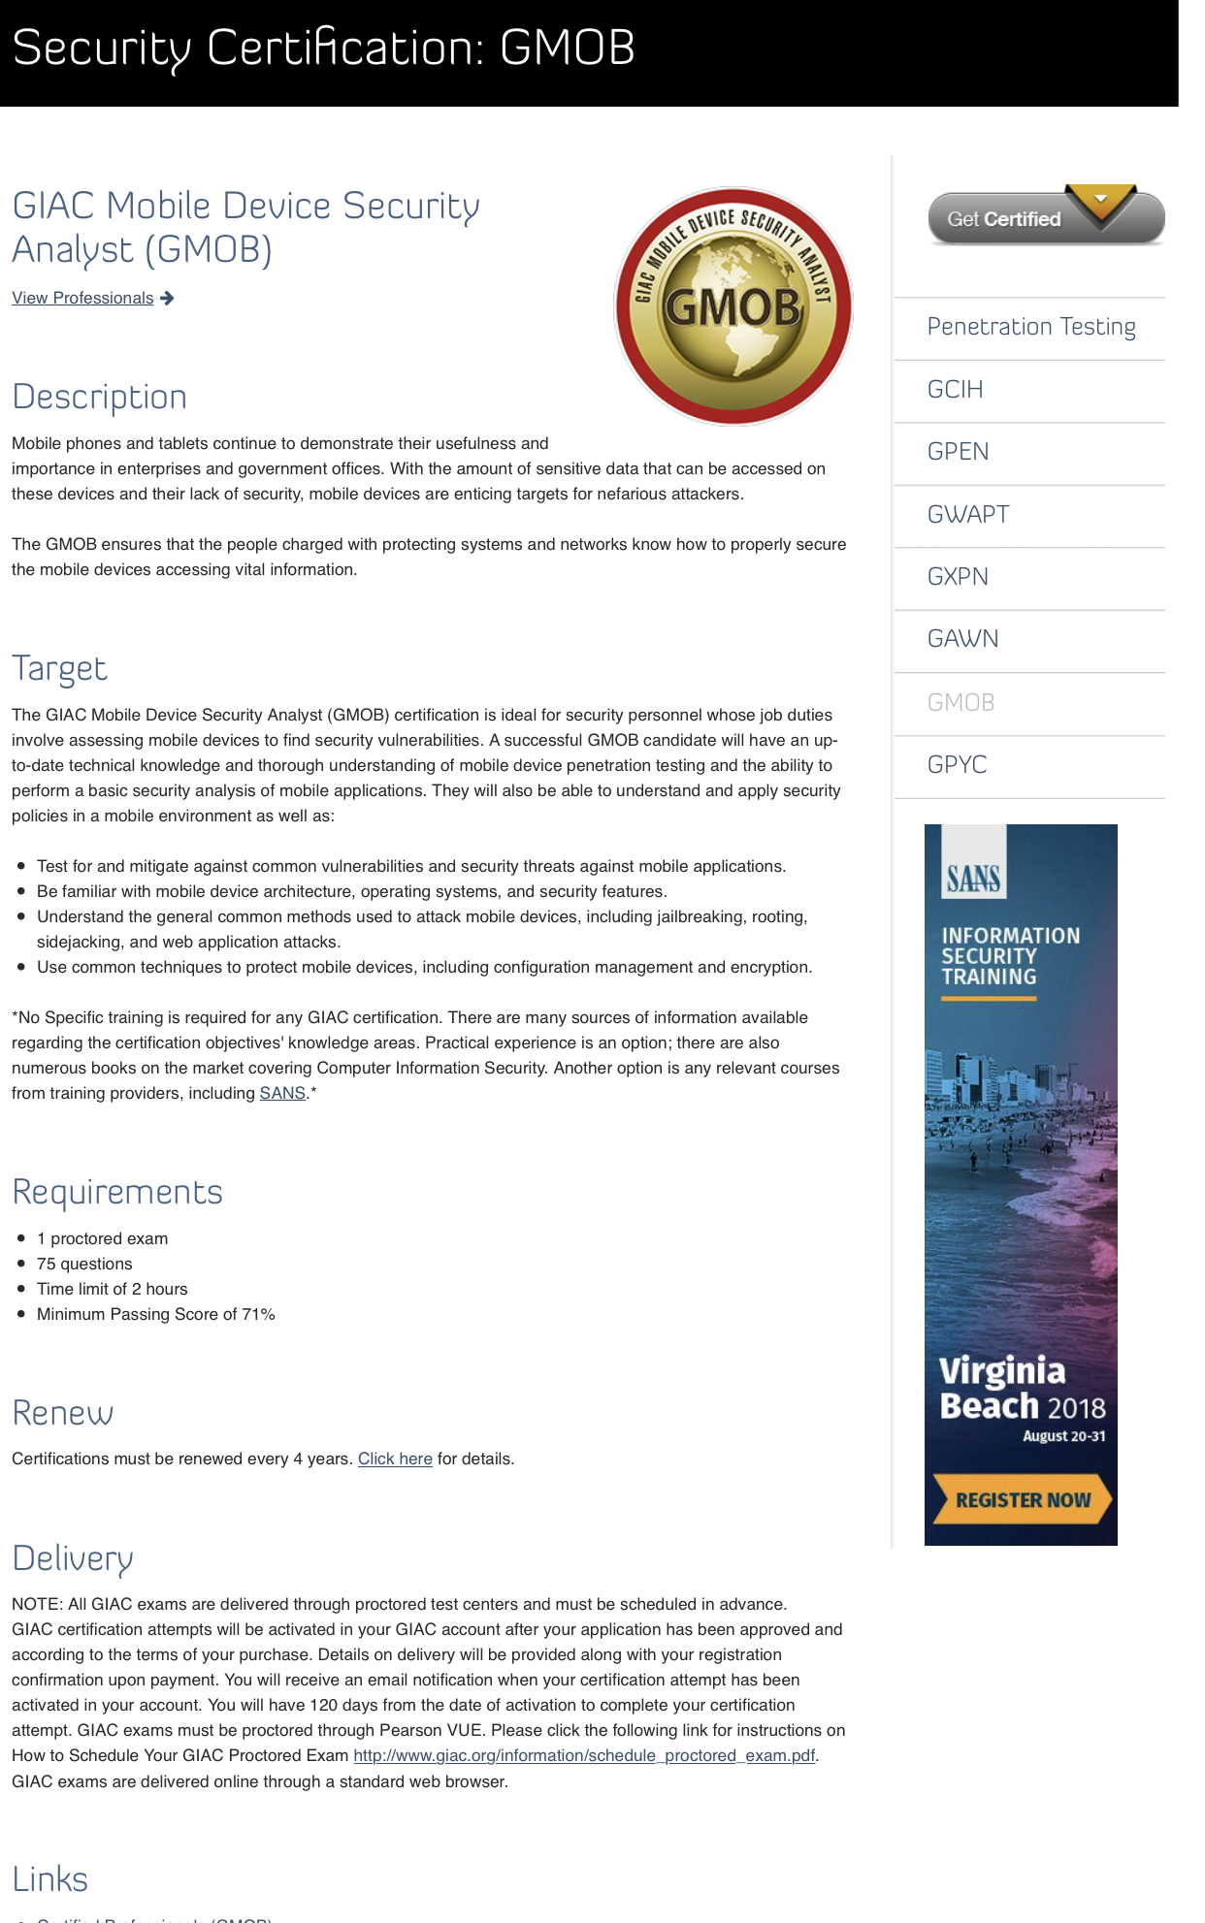



BOOKS
VIDEOS
&
COURSES
@CHMODXX_
@CHMODXX
blog.chmodxx.net

Slide 69


Thank you!
@CHMODXX_
@CHMODXX
blog.chmodxx.net

